Slide 1
Perform Shop Maintenance

Slide 2
Learning Objectives
After the completion of this lesson, learners are expected to:
inspect/clean tools, materials and shop equipment;
store/arrange tools and shop equipment;
dispose waste/used lubricant

Slide 3

Unit 1: Inspect/clean tools, materials and shop equipment
WORKSHOP POLICIES AND SERVICE PROCEDURES
Workshop Policy
The workshop policy applies to all workshop. It entails awareness about legal policies that must be put into practice. It is an understanding of all the hazards that may exist in the workplace. Each person who works at the shop should be required to read the policy and agrees to abide by it. This provides important legal protections in the event of an accident.
Workshop policy includes shop safety. It is the responsibility of everyone. Safety means protecting oneself from injury at all times. Working in the shop requires the use of a large variety of tools, materials, and equipment that can injure the worker and others in the shop if not properly used. A profitable auto shop is a well-run auto shop; a well-run auto shop is a safe one. Automotive mechanic uses power tools if needed, Power tools are usually electrically driven. It means it can work in a span of minute. Therefore, this must be treated with care and respect.

Slide 4
Unit 1: Inspect/clean tools, materials and shop equipment
WORKSHOP POLICIES AND SERVICE PROCEDURES
Workshop Policy
Workshop policy on service procedures from the time the customer comes in and gets out must be strictly followed so that they will be satisfied with the work rendered to them. Workers will also benefit if is obeyed. It means that they will work on the job order issued to them. They should never work on any other orders unless given to them by the person in charge so that healthy working relationship is preserved between the company and the workers.
There is also workshop policy on the use of tools, materials and equipment. Compliance with them will create good management of these implements. Materials like rags, petroleum products, and water are economized; tools hammers, wrenches and screwdrivers are taken care; and use of equipment like air compressor as substitute to electric fan is not misused. Aside from these, use of workshop and office facilities like fans, papers, toiletries, cleaning materials are not abused.

Slide 5
General Requirements of Safety in Workshop Policy
Guidelines for safe practices.
During the course of working in the shop, a general service technician moves from one area of the shop to another, moving parts and equipment around the shop and performing varied tasks. It is important that the shop floor be free of hazards that could cause technicians to slip or trip.
In a wide variety of shop tasks, waste materials are produced that can cause dangerous situations unless the waste materials are disposed of or stored properly.
Always be sure that shop exits are well-marked with an EXIT sign and are clear of obstructions.

Slide 6
General Requirements of Safety in Workshop Policy
Guidelines for safe practices.
4. For personal safety and to help keep the shop free of hazards, always comply with the following safety rules:
Work quietly and focus solely on the job at hand.
Do not leave creepers lay on the floor. Always stand them against the wall, wheels outward, when not in use. c.
Do not indulge in horseplay in the shop; immature and improper behavior can cause serious accidents. d.
Before performing a task, consider the relevant safety precautions related to the task and formulate a prevention plan for each hazard.
Keep the shop free of hazards.
Use appropriate personal protective devices (clothing and equipment)

Slide 7
General Requirements of Safety in Workshop Policy
Guidelines for safe practices.
e. Always wear protective clothing and equipment in any situation where it is necessary. Wear protective eyewear at all times in the shop area.
✓ Do not wear rings, bracelets, watches, or necklaces when working around moving machinery or electrical equipment.
✓ Do not put sharp objects into the pocket of work clothes. They could cause personal injury or damage to vehicles.
✓ Keep hands free from oil and grease.
✓ Wipe off grease and other spills from the shop floor immediately, or at least put an oil-absorbing compound over them.
5. When cleaning up flammable liquids, always dispose of the rags in a metal container with a tight-fitting lid.

Slide 8
General Requirements of Safety in Workshop Policy
Guidelines for safe practices.
6. Do not look in the direction of another person who is welding.
7. Do not run a vehicle engine inside a closed garage unless the vehicle exhaust is hooked up to exhaust ventilation equipment. A deadly amount of carbon monoxide, which is present in the exhaust, can collect in a very short time.
8. Do not smoke in any shop, except in an area designated for smoking.
9. When pumping a flammable liquid from a large container into a small one, be sure to first attach a ground wire between both containers.

Slide 9
STANDARD SAFE HANDLING OF TOOLS, MATERIALS AND EQUIPMENT
Safety in workshop is subject to a number of various risk assessments and safe codes of working practices. This must be adhered to and enforced by those in charge of the workplace. There may be risk activities in the shop by which one must observe properly.
Handling of Tools, Materials, and Equipment Everyone involve in the shop should be trained in proper handling of tools, materials, and equipment. It is necessary for you to recognize them and how they are used. The following information will give you insights on safe handling.

Slide 10
STANDARD SAFE HANDLING OF TOOLS, MATERIALS AND EQUIPMENT
Service of records of all machine tools, materials and equipment must be kept. All information must be complete and done in order.
All portable electrical equipment must be regularly inspected and tested for electrical safety.
There must be a responsible person to take charge of the tools, materials, and equipment before, during and after used.
Every worker involved must be trained according to use of work equipment and tools.
Tools and equipment must be cleaned after use.
There must be proper uniform (apron, shirt, or apron) when working with machine tools or other equipment especially those that have rotating spindles.
Precision measuring equipment, drills, etc. must be placed in their appropriate cabinets after use.

Slide 11
TYPES AND USAGE OF CLEANING CHEMICALS
Cleaning chemicals are used in taking away dirt, dust and hard to remove grime.
Cleaning products have variety of ingredients. They may be safe or toxic depending on how they are used. Cleaning chemicals used in automotive servicing are quite different from the ones used in households. Even though some cleaning materials in households can have small amount of chemicals used in automotive, it cannot surpass the kind of cleaning materials used in automotive because of the different types and extent of their application.
Cleaning products for use in automotive is somehow stronger than other cleaning materials used for garments and other household purpose.

Slide 12
TYPES AND USAGE OF CLEANING CHEMICALS
Cleaning products used in automotive are for plastics, metals, leathers, rubbers and glasses. These types of cleaning products are hazardous and corrosives. That is why, strict compliance with their use must be considered seriously or else this will pose danger to the one using these and to the environment.
Cleaning products used for plastics are somehow not applicable for use in leathers because of some ingredients that do not conform to the latter.
The reason why they differ in types of chemicals mix in the product is the strength of alkalinity and acidity. Strong alkalis are those that have sodium hydroxide and are used in removing paints like paint remover. Heavy-duty alkalis are those that contains sodium carbonate and are used in removing greasy substance like thinner. A mild alkali is a sodium bicarbonate contained chemicals. They are also known as baking soda used in removing oily substance in automobile body before wash-out painting.

Slide 13
TYPES AND USAGE OF CLEANING CHEMICALS
Aside from alkali type of cleaners, the acid base type cleaning chemicals have at least three types. The strong acid cleaners are highly corrosive. They are good in removing hard deposits. Hydrochloric acid or the well-known muriatic acid is a good example of this type. The mild acid cleaners are good in removing rusty stains and blemish. Anti-rust cleaners, wheels and tires dressing compound are good example of this type, and the soft acid cleaners are those that are used in cleaning glasses. This kind of cleaners is available in detergent, liquid, and bar

Slide 14
Unit 2: Store/arrange tools and shop equipment
PERSONAL SAFETY AND LABELING PROCEDURE
Whenever safety is the issue, safety of oneself usually comes to mind. It is a basic instinct for human being to protect himself
Safety in the workshop is not only confined to the use of tools, materials and equipment. To some degree, in workshop, personal safety must come first before anything else. You can replace broken tools with new one. Buy new materials and operate new equipment but you cannot buy new body as replacement if something happens to it.
Personal safety involves habits, values, and awareness. Having these virtues will shy you away from injury and harm

Slide 15
Unit 2: Store/arrange tools and shop equipment
PERSONAL SAFETY AND LABELING PROCEDURE
To be more specific, personal safety can be classified in different manners
Upper body protection. These includes safety glass for eye protection called goggles. This is used when grinding metal or when reconditioning tools. Welding goggles are also used when joining metals so that eyes are protected from flying debris. Transparent goggles are useful when working under chassis. Eyes are protected from dust and small particles that may get into the eyes and cause irritation. The head should be protected with head gear like bonnet or cap. This head gear protects head and hair from dust, accumulated dirt, falling object and harmful chemical especially when working underneath the vehicle. The nose and face should be protected with face mask or respirator so that harmful fumes from exhaust gas and chemicals may not get into the lungs.

Slide 16
Unit 2: Store/arrange tools and shop equipment
PERSONAL SAFETY AND LABELING PROCEDURE
2. Middle body protection. These include apron that protects the body from dirt and sudden spill of substance like oil. High grade rubber gloves protect the hands from paint, solvent and electrical shock. Leather gloves protect the hands from hot surface like newly welded metal to avoid abrasion. Hand cream is also useful to protect hands from dryness
3. Lower body protection. These include safety shoes to protect the feet from slipping and risk from heavy falling object.
4. Whole body protection. The use of coveralls or jumpsuit is a good protection against flying debris, chemical spill, paint, solvent and abrasion.

Slide 17
Unit 2: Store/arrange tools and shop equipment
PERSONAL SAFETY AND LABELING PROCEDURE
Aside from the different implements to protect self from any harmful injury, labeling of warning signs and symbols must be clearly written and properly identified.
Labels must be color coded. Usually a red color code is a sign of danger sign. It gives you information on the seriousness of consequence if not followed. Yellow color code can mean warning. It gives information to forewarn you from danger. A green color code may mean safe. It is good that workplace be posted with properly labeled signs, symbols, and stickers.

Slide 18
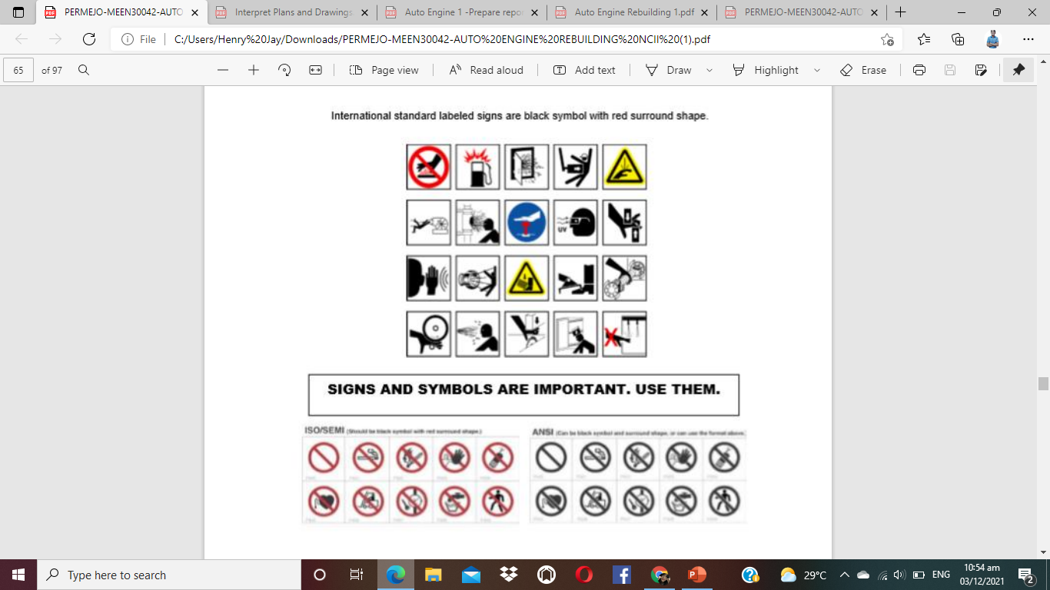
Unit 2: Store/arrange tools and shop equipment

Slide 19
PRINCIPLES OF TOTAL QUALITY MANAGEMENT (TQM) - 5 S
The total quality management in automotive servicing is getting the job done with excellence and direction. This is one of the principles that should be implemented in order for the management to work. One of the key principles is the proper maintenance of the shop. To be effective, there must be some methods to work on. One is the management of peopleware. They are the ones that need sustainable training in the shop and workshop environment. This increases their manpower capability in the field of work. Because of this, they become assets in managing the shop. Increasing their skills also increases their values and worth. Therefore, it decreases the chance of accidents and expenses in the workplace by applying corrective and preventive maintenance. These corrective and preventive measures also include the hardware. The hardware part of management in automotive servicing are the workshop facilities like the tools, materials, equipment/machineries including facilities like furniture, lighting, water, and furniture. Proper management of these hardware results in cost effective expenses in the workplace.

Slide 20
PRINCIPLES OF TOTAL QUALITY MANAGEMENT (TQM) - 5 S
In Japan, they use the 5 S principles of management for increase efficiency and effectiveness in the workplace. These 5 S principles of management will help you a lot in sorting, setting in order/simplifying, sweeping, standardizing, and sustaining.
1. Sorting – a process of taking things that are needed and taking away those that are not needed anymore. In this way, eliminating unnecessary items gives more free space to those items that are needed. To be more specific, those items for disposal must be marked or tagged with appropriate color for easy identification. Sample guide questions:
What items should be eliminated?
What items should be retained?
What items can be reconditioned/ repaired?

Slide 21
PRINCIPLES OF TOTAL QUALITY MANAGEMENT (TQM) - 5 S
2. Setting in order, Straightening, simplifying – a process of making things easy to see, easy to get and easy to return. Sample guide questions:
Where is the tool, materials, and equipment located?
What tools, materials, and equipment are common?
Where is the best location for each of them to be placed?
3. Sweeping, Shining, Systematic cleaning – a process of clearing out the dirt, dust and residual grime to make the space, machines, and fixtures clean. Examples are:
What location or machines need immediate and regular clean-up?
Which of them should be cleaned first?

Slide 22
PRINCIPLES OF TOTAL QUALITY MANAGEMENT (TQM) - 5 S
4.Standardizing - process of having a uniform procedures of work or placement of things in proper place. Examples are:
How the procedures done?
What is the schedule of work from start to finish? Where should the finished work be placed?
Who will be in-charge of testing the work?
5.Sustaining - a process of maintaining a continuous and consistent implementation of doing the 5 S principles.
With these 5 S in mind as tool for management principles, it is expected that it can build a good workshop and workplace environment that in the process it will result in shop maintenance, efficiency and effectiveness.

Slide 23
Unit 3 : Dispose waste/ used lubricants
WASTE MANAGEMENT
Industrial waste materials are a great concern of environmentalists. Their harmful effect is so huge that it even affects our environment and climate. This is due to improper management of waste materials such as cleaning chemicals used in automotive like solvent, used lubricating and flushing oil, paint remover, and thinners. Problems like these can be solved if proper attention, information dissemination, and training are adequately provided in the workplace.

Slide 24
Unit 3 : Dispose waste/ used lubricants
WASTE MANAGEMENT
Government institutions like the Department of Environment and Natural Resources (DENR) have local policies that protect the citizens from harmful effects these hazardous materials and substance may bring. Hazardous materials are those that can be found in the workshop such as toxic materials like hydrochloric use in cleaning metal surface and sulfuric acid use in the battery, and Turco or metal conditioner for neutralizing rust. Flammable materials like fuel gasoline and thinners are also used in cleaning engine parts. They can give harmful fumes that can generate respiratory and skin irritation. Materials that can easily dissolve metal like anti-rusts are corrosive materials. Acid, soldering paste, and Turco can be classified as reactive materials that can immediately change the composition of an object.

Slide 25
Unit 3 : Dispose waste/ used lubricants
All of these hazardous, waste materials and substance can paralyze human and definitely lethal if not given serious attention in managing them. The following are some guidelines to follow when disposing waste and used materials and substance.
1. Have a separate container or trash bin for disposable materials. Different waste materials like used, empty plastics, bottles, cans must not be mixed in one container for easy disposal and segregation.
2. Have a separate container for used and unused materials and substance. Used oil must not be disposed in the drainage. Doing so will harm the eco-system. This will endanger the lives of water life species and plant life. This must be stored in a container with proper label. Unused oil and other chemical materials must be properly labeled and covered to avoid escape of fumes that may cause instant fire. In the United States the Environment Protection Agency (EPA) is very strict in implementing protection against careless and improper use and disposal of hazardous waste products. Breaking this law may lead to prosecution.

Slide 26
Unit 3 : Dispose waste/ used lubricants
3. Have an appropriate amount of use of chemical materials or substance. Many unused chemical materials and substance are due to overfill. That is why the excess chemicals cannot be returned back to its container especially if already mixed with other chemicals and cannot be stored for a period of time. This overfill when stored and dried tend to form into another composition and thereby unsafe to use. Disposal of this kind is a problem.

Slide 27
EFFECTS OF AUTOMOTIVE WASTE TO MEN AND ITS ENVIRONMENT
The effects of hazardous waste materials to human and environment in inconceivable. Just imagine the amount spent by the government in services for managing this problem. Aside from this, the audio and print media release they have paid just to promote waste management literacy.
Millions of automobile are on the road every day. Toxic exhaust gas fumes may lead to respiratory disease, and even death. Heat produced may cause skin irritation and respiratory allergy, and other by-products of automotive wastes can cause physical, mental and financial stress.

Slide 28
EFFECTS OF AUTOMOTIVE WASTE TO MEN AND ITS ENVIRONMENT
An inventory of waste materials and substance that can be found in the workshop will be of great help in finding out their condition.
Managing the hazardous waste materials and substance is a great contribution to the nation’s economy. Health and safety are preserved. Injury is lessened and harmful effect to environment is reduced if not totally removed.

Slide 29
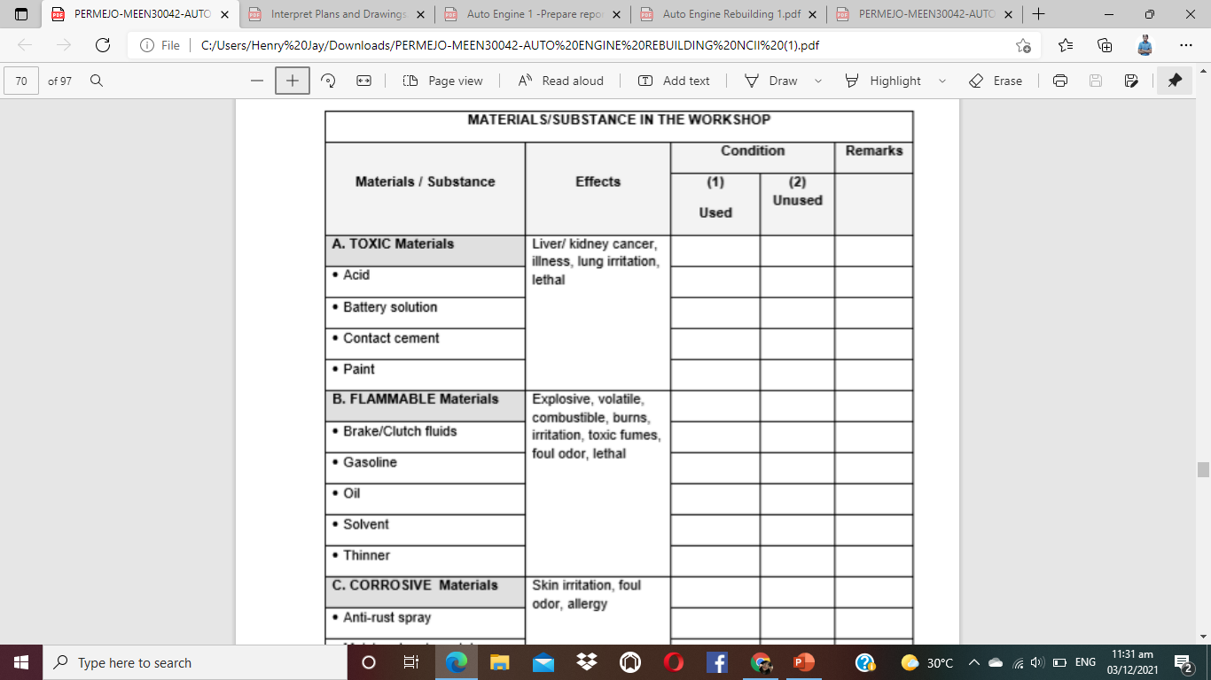

Slide 30
